Slide 1
Summer R Workshop 1
Matthew D. Turner
mturner46@gsu.edu
Department of Psychology
Georgia State University

Slide 2
R at GSU
This past spring we started a new R Users Group
It began as a regular meeting in psychology convened by Chris Goode
I basically hijacked it to start a GSU-wide users group
If you are not on the email list, please add it or contact me (mturner46@gsu.edu) to be added
We were overwhelmed with the response
Biggest Need at GSU: Training

Slide 3
What is R?
R is a variant of the S programming language
The S language was developed in 1976 at Bell Labs
S was designed for data analysis and statistical modeling
S Developers: Rick Becker, Allan Wilks, John Chambers
S was developed by people working on particularly hard data analysis problems where standard solutions did not usually apply
S “glued together” smaller modules written in C
S Goal: “to turn ideas into software, quickly and faithfully” (Chambers)

Slide 4
What is R?
C, APL, Fortran → S → S-Plus → R
R was developed by Ross Ihaka and Robert Gentleman at University of Auckland, New Zealand
It is an open source version of the commercial language S-Plus
S-Plus was an earlier derivative of S developed by Statistical Sciences, Inc. (SF, CA)
S-Plus introduces many features not in the original S (OOP)
S-Plus was basically made non-viable as a commercial product due to R
R is now the dominant dialect of this family of S based languages

Slide 5
What is R?
S/R is an opinionated language, it emphasizes:
“Exploratory data analysis” (Tukey’s ill-conceived term)
Quick/Exploratory Graphics
Easy and direct mathematical manipulations in models
Programmatic interface to analysis (functions)
R is an evolutionary product
Many of its features only make sense if you know the history
“Vestigial” components abound!

Slide 6
What is R?
R is now an international project
R language is controlled by the R Core Team
Managed by the R Consortium:
www.r-consortium.org
Shared/Delivered by CRAN: cran.r-project.org
Package development is shared by the global R community

Slide 7
What is R?
For most people R is:
A general purpose computer language for data
A statistics language
I’m assuming you hare here because you want to know R to do something with data
R is the koiné of the data science and statistics worlds
Most new statistics are implemented in R before they are elsewhere
If you want a job at a data intensive startup you better know R (and Python)

Slide 8
Jupyter Notebooks
There are two common styles of interface to scientific computing software
Window-pane GUI AKA Matlab-style
Notebooks AKA Mathematica-style

Slide 10
Graphics appear in another pane like here.
Enter commands here into a “script” file.
See results of commands in this window.

Slide 11
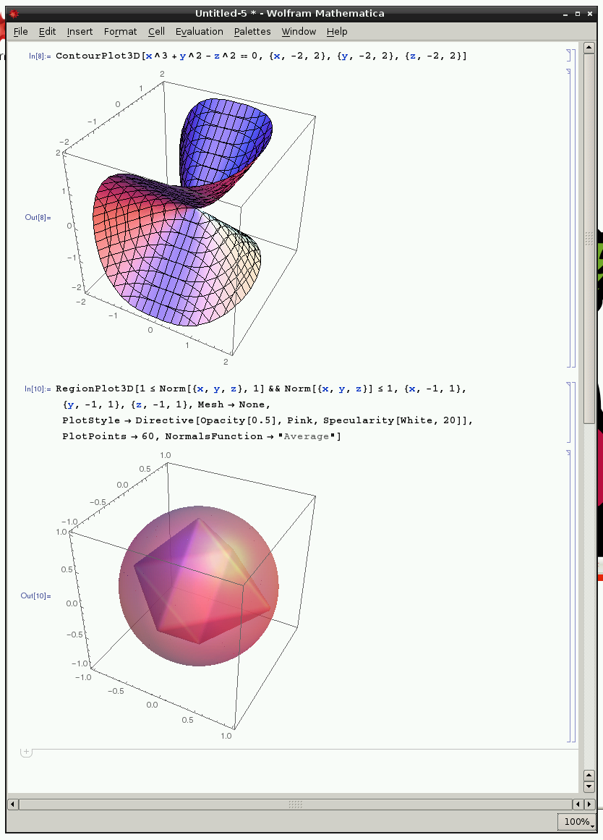

Slide 12
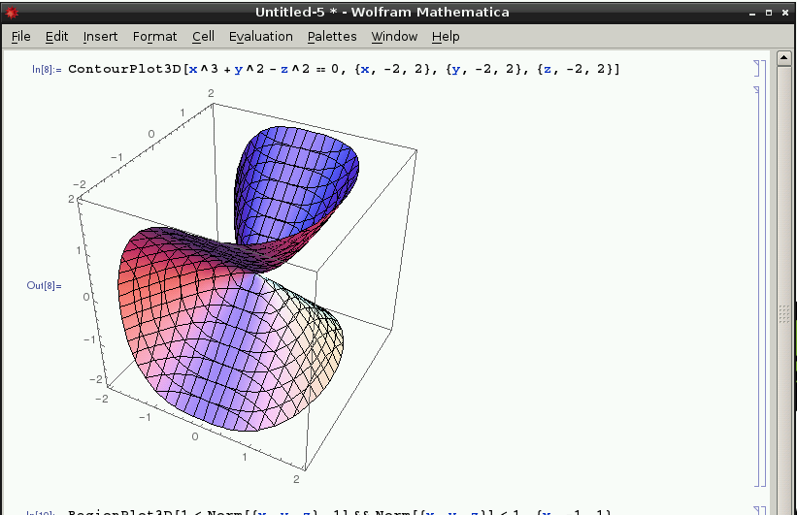
Everything appears in one window, in sequence.
Each input is followed by…
Its corresponding output.

Slide 13
Jupyter Notebooks
There are two common styles of interface to scientific computing software
Window-pane GUI AKA Matlab-style
Notebooks AKA Mathematica-style
For R both are available
RStudio implements the Matlab-style interface
Jupyter implements the Mathematica-style interface
R is the SAME in both!
Both RStudio and Jupyter use exactly the same R “server” underneath
Same language, same implementation, same everything

Slide 14
Scientific Software Architecture
Client
Browser / Interface
Commands
Server
R Server / Other
One nice feature of this design is that it works cross-platform – that is, PC/Mac/Linux works the same.
Graphs/Results
The server part of this can be located anywhere you are connected to:
On the internet (like today): https://dice.gsu.edu:8000/hub/login
On the same computer as the client: http://localhost:5000

Slide 15
Jupyter Notebooks
If you like Jupyter it supports most scientific programming languages:
Old timey: FORTRAN (coarray-fortran 2008)
Statistics programming: SAS, R, Incanter/Clojure
Math programming: Matlab, Julia (IJulia), Maxima,
Plotting/Graphics: Gnuplot, D3/Javascript
AI: prolog, smalltalk, Mathematica, scheme (LISP dialect)
Web languages: Ruby, Haskell, Javascript, Coffeescript
System languages: C, Go, Scala, Erlang, bash, Kotlin
And many more
https://github.com/jupyter/jupyter/wiki/Jupyter-kernels

Slide 16
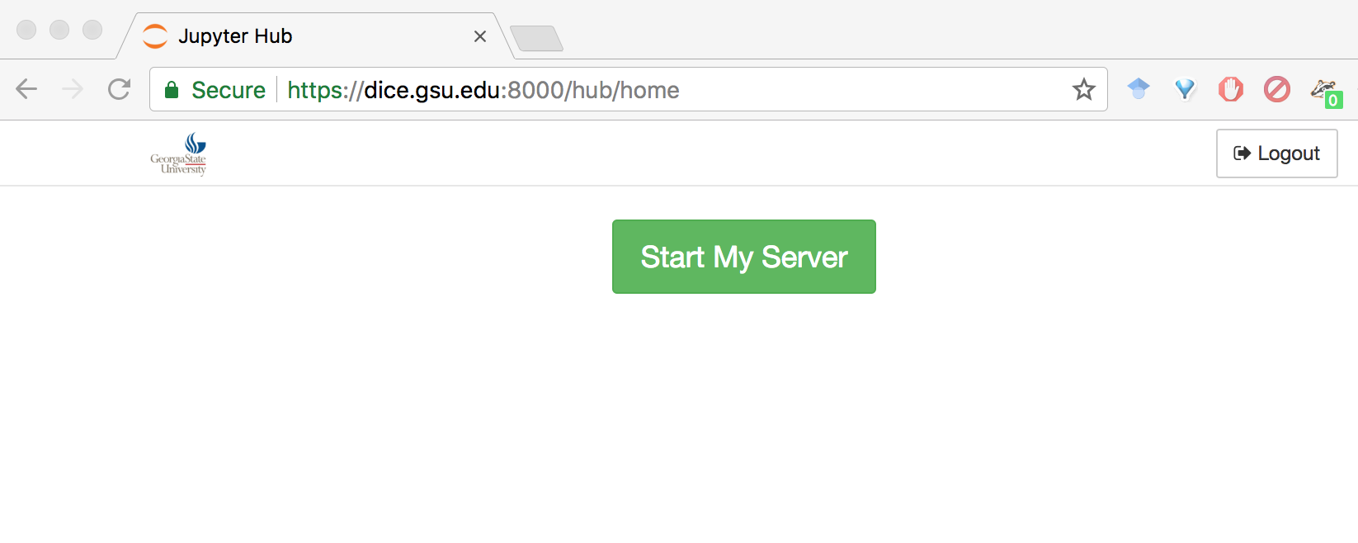
Workshop
Log into DICE:
https://dice.gsu.edu:8000/hub/login
The minimal address: dice.gsu.edu:8000 should work, but sometimes does not
Then you see this:
Click the “Start My Server” button.

Slide 17
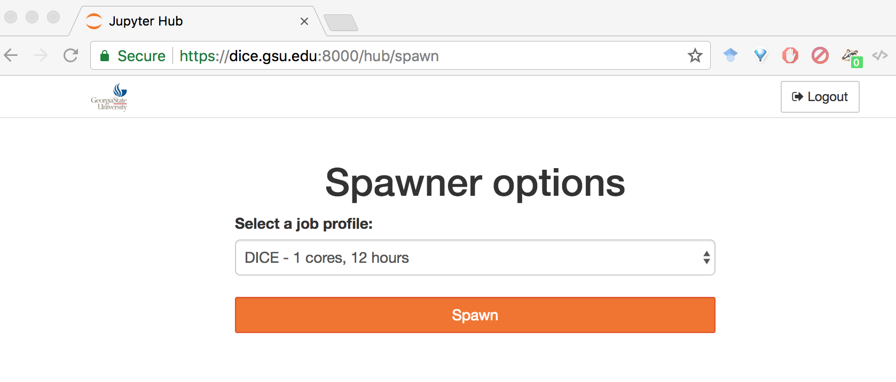
Please pick:
1 core, 12 hours
Click the “Spawn” button ONCE. Then wait…

Slide 18
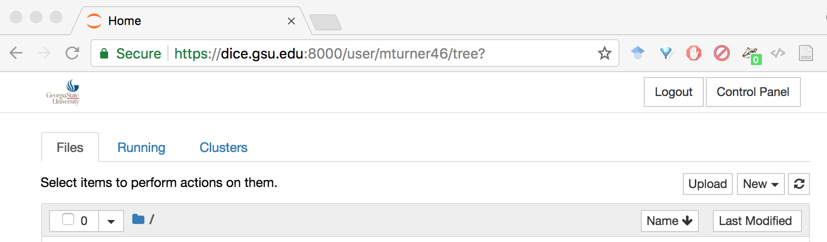
When you see a page where the TOP of the page looks like this, you are ready to start!

Slide 19
DICE Demo

Slide 20
Today’s Files
Click on the folder: IntroR01
And within that folder: ClassNotes
The Jupyter notebooks for today are numbered from 01 to 05
Launch the first and go!

Slide 21
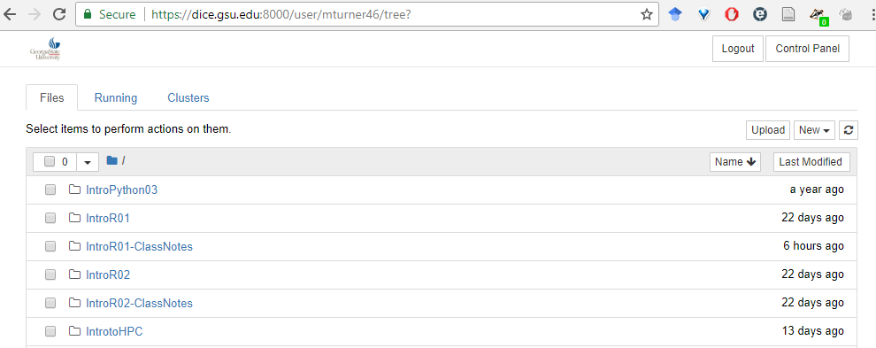
If you picked an option other than 1 core, 12 hours, please click
on “control panel”

Slide 22
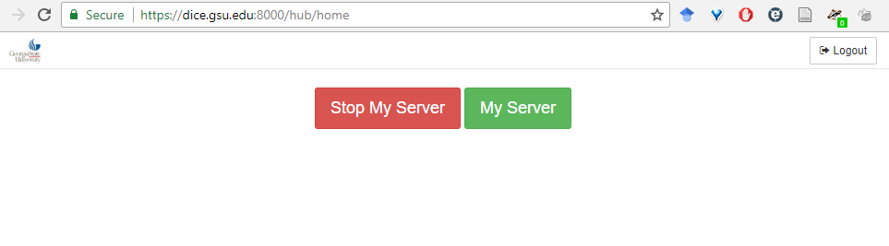
If you picked an option other than 1 core, 12 hours, please click
on “control panel”
Then click on “Stop My Server.” This will return you to the spawner page where you can choose the correct option.

Slide 25
Workshop
Log into DICE:
https://dice.gsu.edu:8000/hub/login
The minimal address: dice.gsu.edu:8000 should work, but sometimes does not
Then you see this:
Click the “Start My Server” button.

Slide 26
DICE Spawn
Please choose the 1 core, 12 hour option. If you choose the others the system will be slow for everyone!

Slide 27
Workshop
Log into DICE:
https://dice.gsu.edu:8000/hub/login
The minimal address: dice.gsu.edu:8000 should work, but sometimes does not
Then you see this:
Click the “Start My Server” button.

Slide 28
Click the “Spawn” button ONCE. Then wait…

Slide 29
When you see a page where the TOP of the page looks like this, you are ready to start!

